Slide 1
Analysis of Sports Gambling in the U.S.
Michael Alberts
Jeffrey Bridges
Ryan Hartquist
Andrew Kuchel

Slide 2
Overview
BACKGROUND HISTORY
Federal law in 1992 prohibited most states from authorizing sports betting
Supreme Court ruling in 2018 overturned law
SINCE RULING
18 states have legalized and operational sports betting
4 more states have legalized without operations
9 more states have active state bills
12 more states have failed legislation

Slide 3
Project Objectives
Identify trends and growth in revenue from sports betting
Compare and analyze additional revenue generated in states with legalized sports betting
Prepare a model to evaluate potential revenue in new states
Compare and analyze the demographics between states
Use sports revenue compared to overall revenue
Identify best model
Use known state data
Use model to predict revenue for states that have yet to legalize or operate

Slide 4


Data - Access
The variables of this project:
Identify trends and growth in revenue from sports betting
Prepare a model to evaluate potential revenue in new states
https://www.legalsportsreport.com/
Handle
Bet Revenue
Hold %
Taxes
https://www.taxadmin.org
Total Tax Revenue
Per Capita Taxes
https://www.kff.org/
Population demographics
https://en.wikipedia.org/wiki/List_of_U.S._states_and_territories_by_income
Data based on age bracket

Slide 5
Data – Consolidation and Cleaning
Data Consolidation
Data Cleaning
Most consolidation performed by scripts
While gathering data, not after the fact
State Name used as primary key to correctly merge data frames
Removal of U.S. Territories and Washington D.C. done manually
Very few missing values
Convert scraped data from ‘Character’ to ‘Numeric’
Performed on every column of data besides State Name
Created two complete data frames to be used for analysis
1st data frame related to Sports Gambling Revenues/Taxes
2nd data frame related to State Demographics

Slide 6
Data – Transformation and Reduction
Data Transformation
Data Reduction
Created variables to calculate % of sports betting in relation to total tax
Summed up sports gambling tax per state, per year and merged data frames
Removal of Nevada from any further analysis
Nevada has had legalized gambling since 1949, skewing data significantly

Slide 7
Model Building
Regression
Simple “baseline” model
Ability to determine the relative influence of predictor variables on target
Must assess assumptions

Slide 8
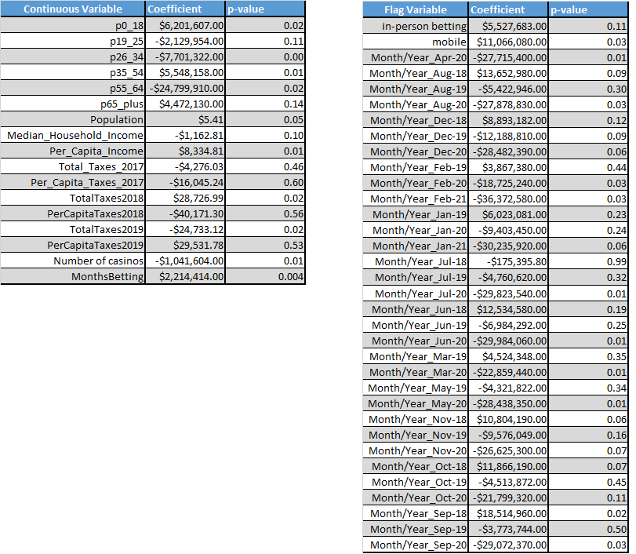
Model Building
Regression

Slide 9

Model Building
Neural Network
Can handle non-linear data with a large number of inputs
Model functions as a ‘black-box’
Hard to see what variables influence results
Predictor variables must be scaled
Model is built/tuned by changing activation function, solver, number and size of hidden layers

Slide 10
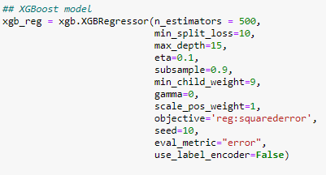
Model Building
XGBoost
Implementation of Gradient Boosted Decision Trees
Ensemble model technique where overall model corrects errors by adding more models
Allows for seeing most influential features
Outputs a tree for rule-based determination of target variable
Model tuned by in-depth hyper parameters

Slide 11
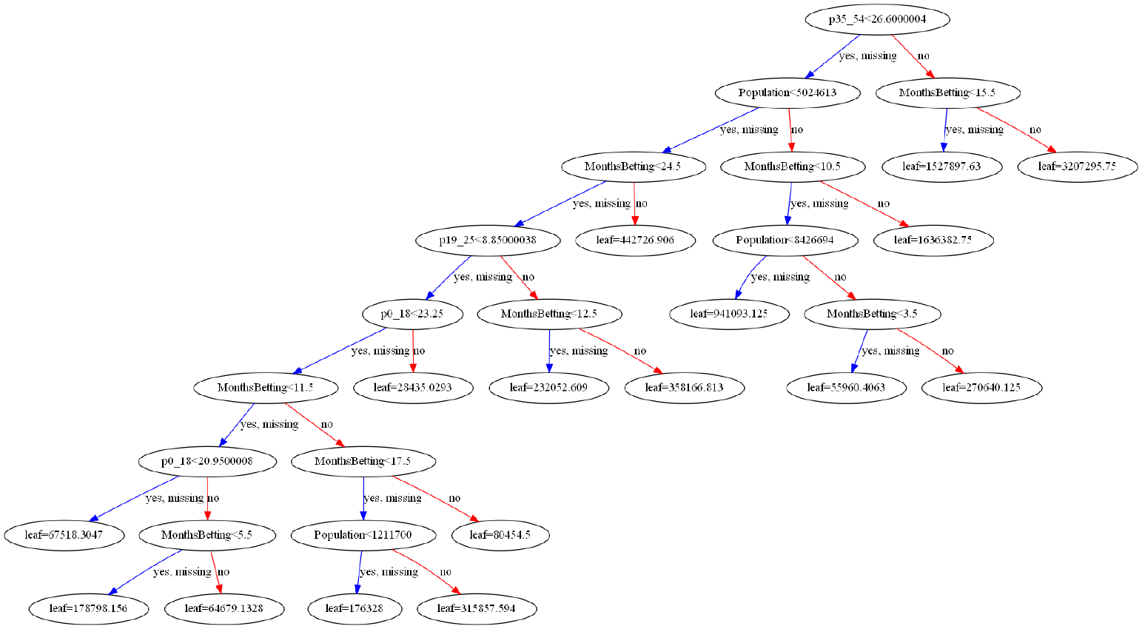
Model Building
XGBoost

Slide 12
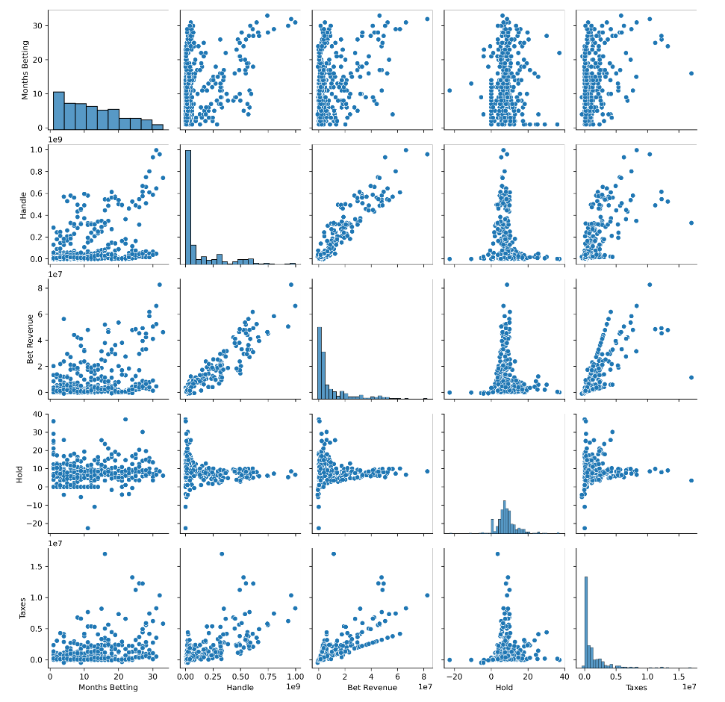
Visualization and Analysis

Slide 13
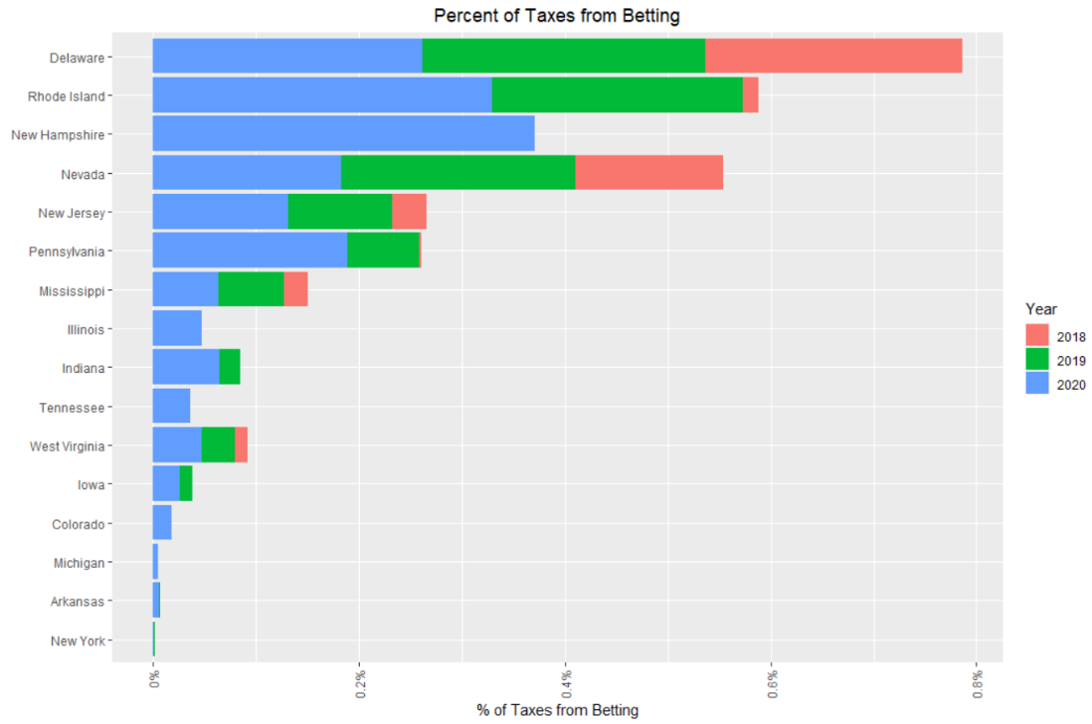
Visualization and Analysis

Slide 14
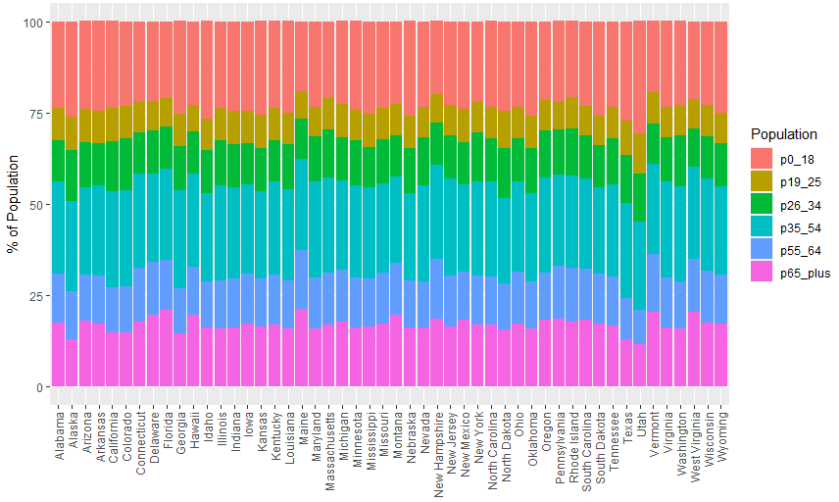
Visualization and Analysis

Slide 15
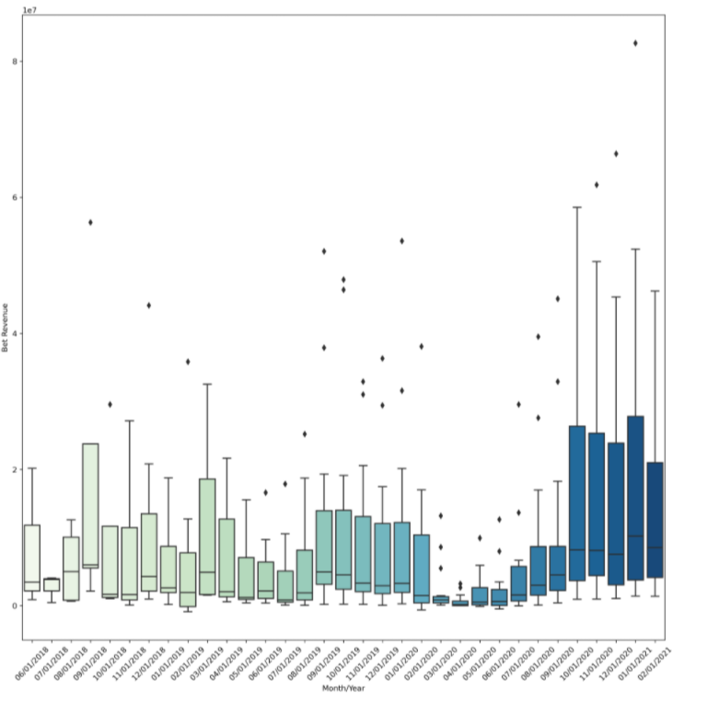
Visualization and Analysis

Slide 16


Model Results
Linear Regression
Neural Network
XGBoost
Regression lowest overall model on all metrics
XGBoost model performs well on training, but overfitting
Neural Network performs best as the most well-rounded

Slide 17
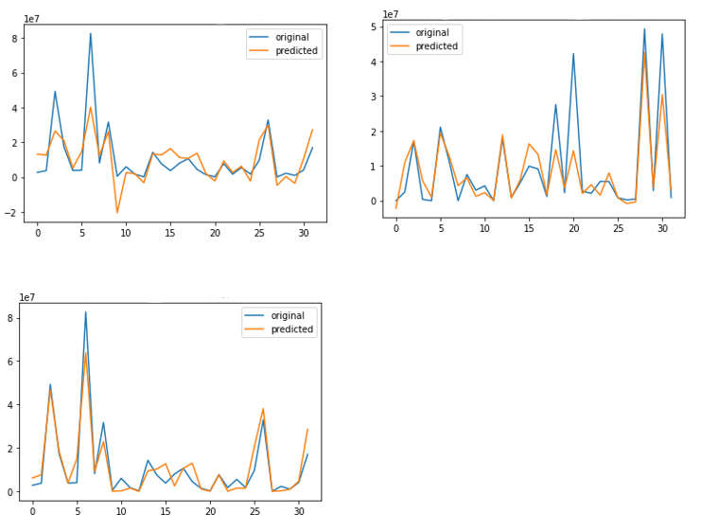
Model Results
Linear Regression
XGBoost
Neural Network
LR tends to under fit on most points
NN picks up much more of the nuance that other models
XGBoost predicts lower values well, but struggles where months have high bet revenue

Slide 18
Final Choice
Linear Regression
Neural Network
XGBoost
Works best with our non-linear data
Better goodness of fit on validation and test
Minimizing error is most important for revenue prediction

Slide 19
Original Vision vs Final Product
Original Vision
Final Product
Original vision was to analyze and predict betting revenue for legalized sports betting.
Final product provided a well-working model that predicts betting revenue for states that have not legalized sports betting.

Slide 20
Conclusion:
Recommendations
Lessons Learned
States that legalize sports gambling have an opportunity to introduce a new source of income.
Would require states to establish appropriate infrastructure and oversight for legalized sports gambling.
Use a state’s demographic profile to accurately predict budget strategy.
Variables did not influence the model to our initial expectations.
COVID-19 pandemic influence.
Adolescence of sports betting increases complexity and volatility.

